Slide 1
OSG202 LAB 04
ASSIGNMENT REPORT
Programming in Shell
Student
ID
Class
Nguyễn Đăng Lộc
SE160199 SE1602

Slide 2
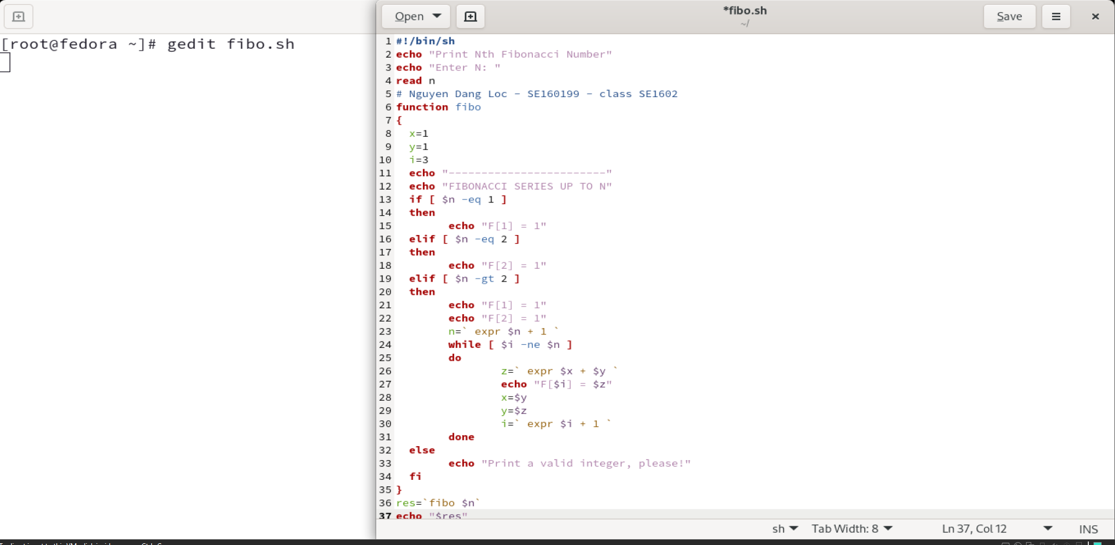
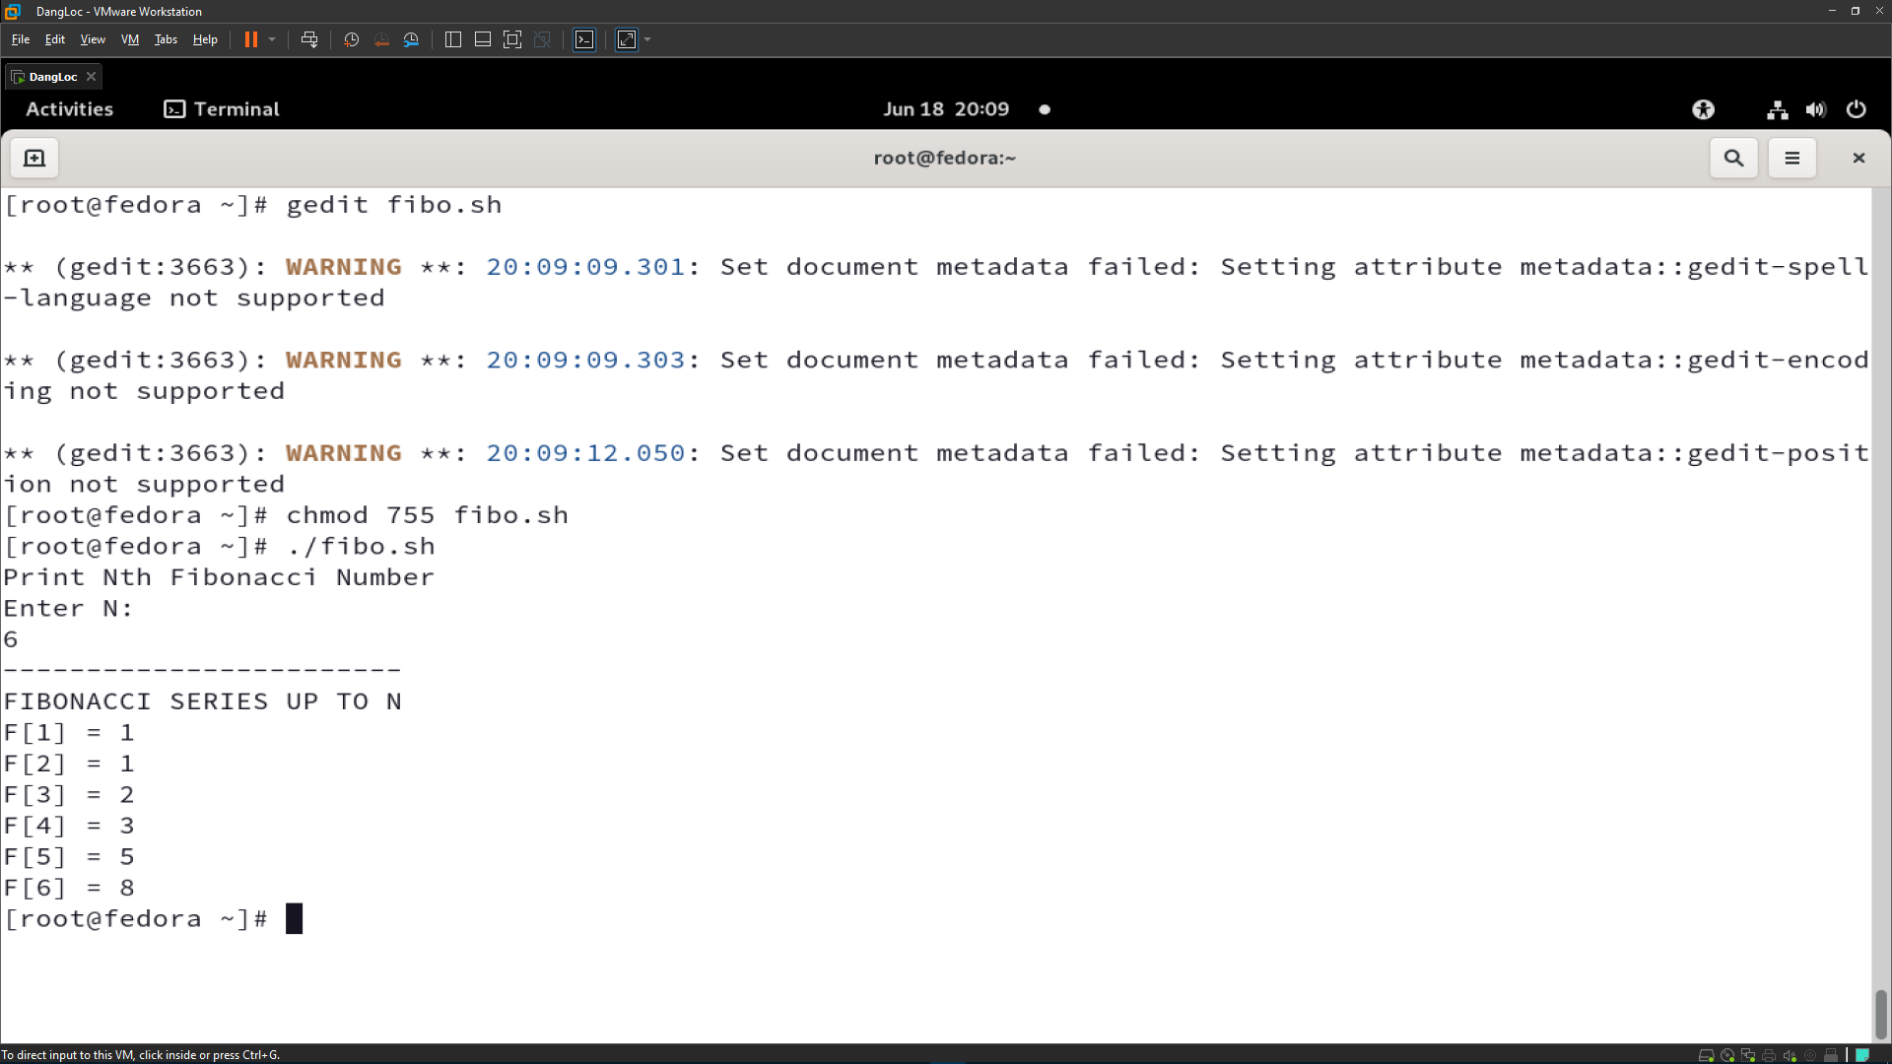
Fibonacci program in Shell
I use GEDIT (editor supplied with the GNOME desktop environment)
Because I feel it easy to use and it also has syntax highlighting, vary color of parameters, variables.
After typing command line gedit fibo.sh, a new window of editor pop up and I wrote my code there.
Save the code and back to the terminal, there was some warning by I still don’t know how to fix it, but it’s not a very serious problem.
02

Slide 3
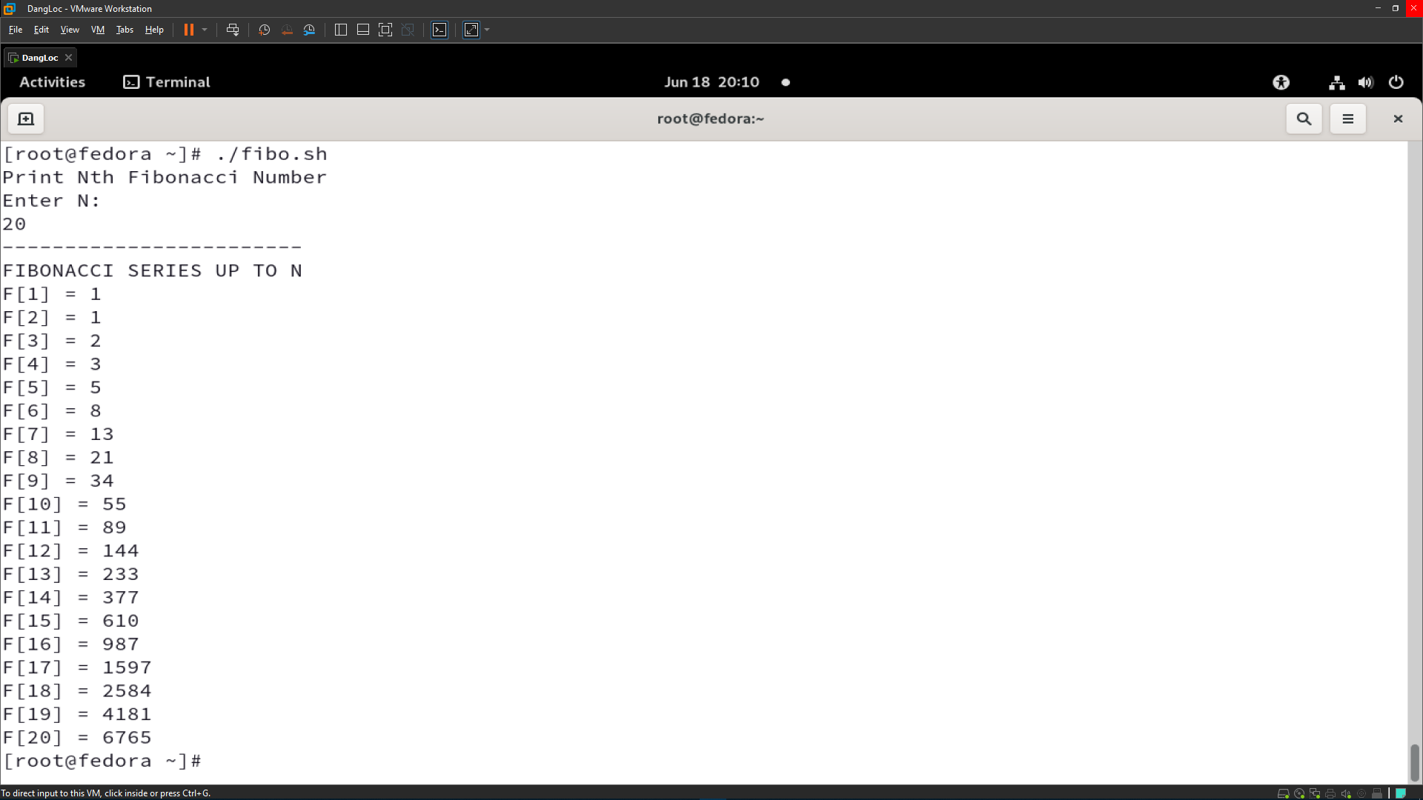
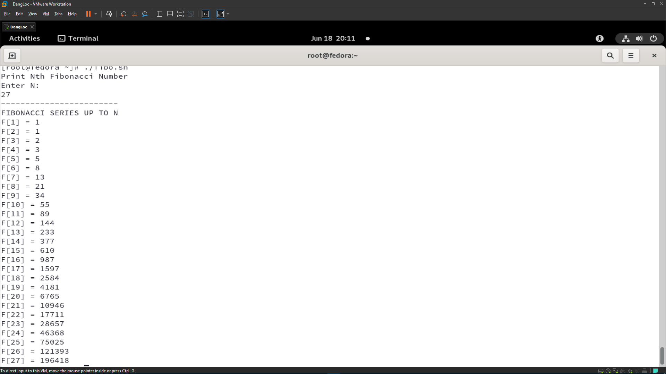
I test the program with some values (as shown below).
03

Slide 4
My source code of FIBONACCI program in Shell script.
#!/bin/sh
echo "Print Nth Fibonacci Number"
echo "Enter N: "
read n
# Nguyen Dang Loc - SE160199 - class SE1602
function fibo
{
x=1
y=1
i=3
echo "------------------------"
echo "FIBONACCI SERIES UP TO N"
if [ $n -eq 1 ]
then
echo "F[1] = 1"
elif [ $n -eq 2 ]
then
echo "F[2] = 1"
elif [ $n -gt 2 ]
then
echo "F[1] = 1"
echo "F[2] = 1"
n=` expr $n + 1 `
while [ $i -ne $n ]
do
z=` expr $x + $y `
echo "F[$i] = $z"
x=$y
y=$z
i=` expr $i + 1 `
done
else
echo "Print a valid integer, please!"
fi
}
res=`fibo $n`
echo "$res"
04

Slide 5
Thank you!
By Nguyen Dang Loc

